Slide 1

Saw-Scaled viper (Echis carinatus) Detection and Supervision with Mask-R-CNN
Project by -
Durgeshwari Naik - 17115027
Kuldeep Narayan Minj - 17115037
Guided by -
Dr. Dilip Singh Sisodia

Slide 2
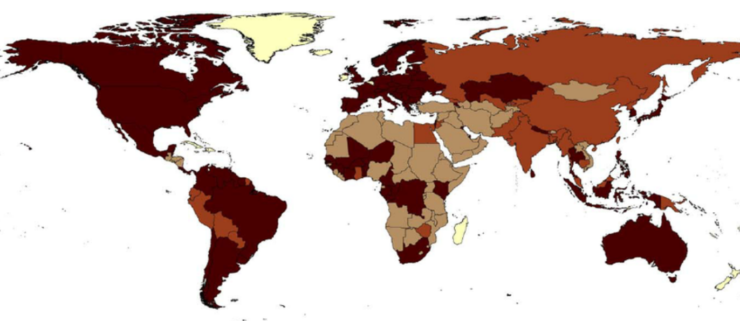
Problem of CONCERN
WHO estimated over 5.4 million people are bitten each year
81,000–138,000 people die each year from snakebites worldwide
Permanent disabilities Even after bite survival
Permanent body parts paralysis
bleeding disorders
irreversible kidney failure
tissue damage
World map : darker regions shows high alert for snake bites.

Slide 3
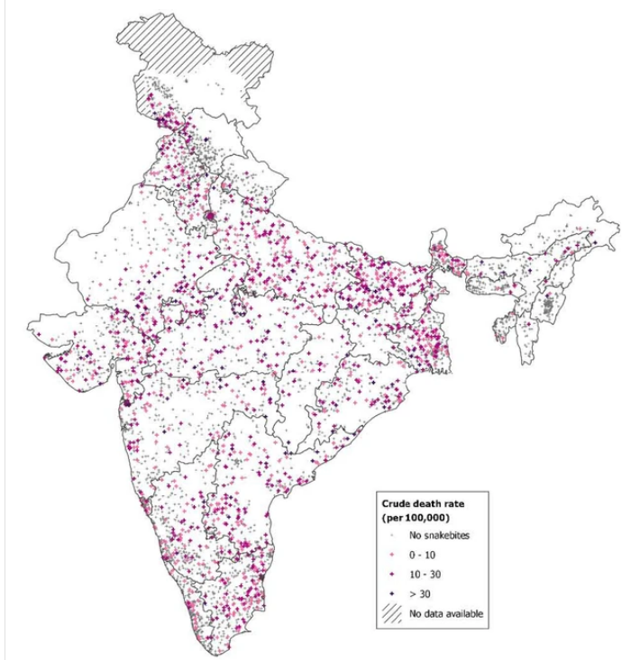
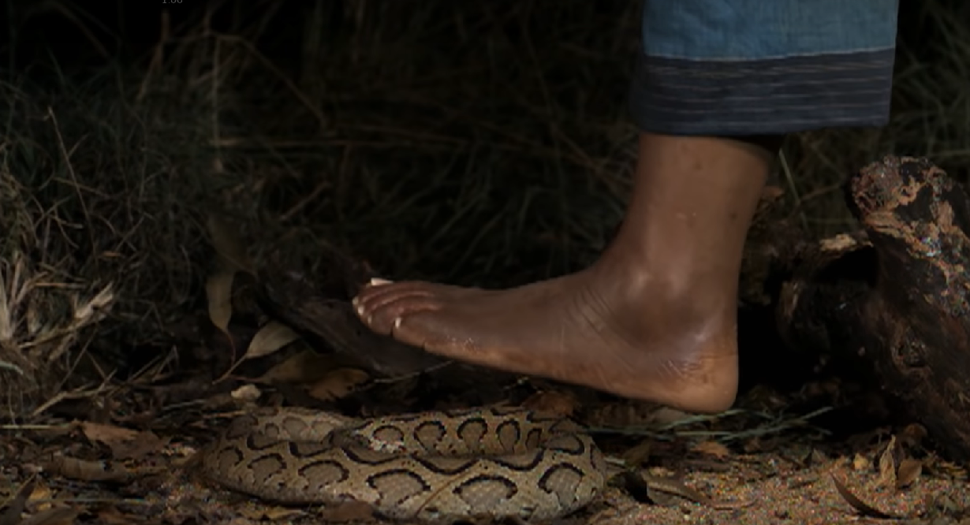
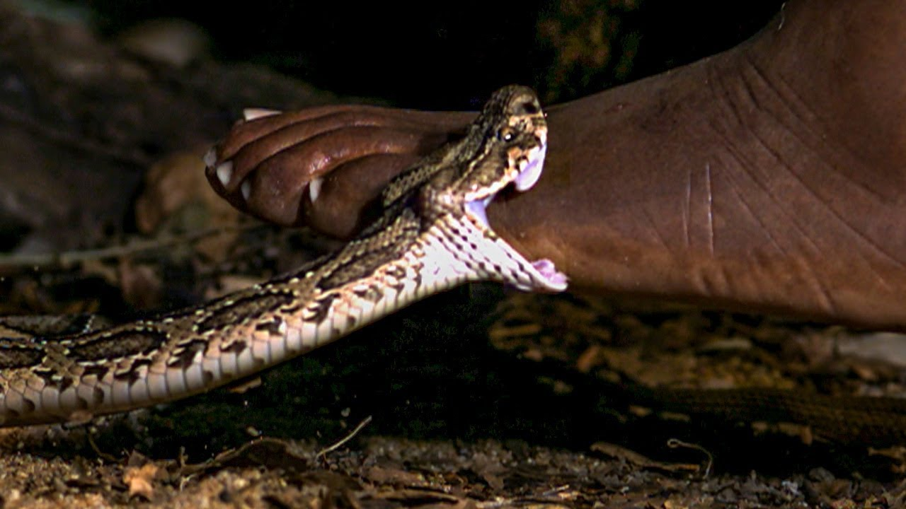
Concern for India
India had 1.2 million snakebite deaths (average 58,000/year) from 2000 to 2019.
the most heavily affected country in the world from snake bites.

Slide 4
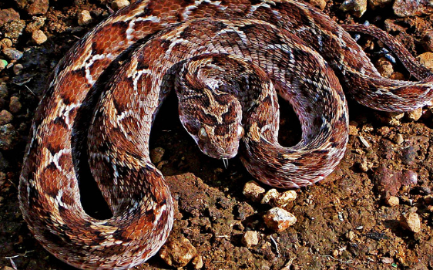
Why we have chosen Echis Carinatus (Saw-scaled viper) as Our main Object ?
The deadliest of all snakes
Responsible for more human deaths than all other snake species combined.
Childrens are more Prone to bites.
Found Around Household, parks, grounds.
No Proper labelled Dataset Available in web Sources for Saw-scaled viper detection for Deep learning algorithms.

Slide 5
The challenge
Detection and Supervision of Saw-scaled viper Around Human Household With Deep Learning

Slide 6
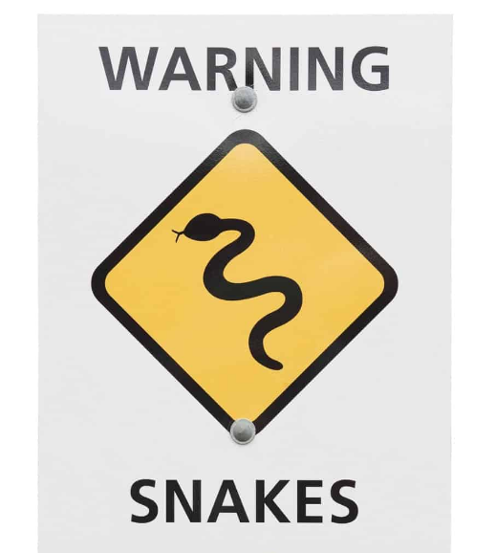
How we are Solving this problem ?
Create a Deep Learning Model Trained to Detect Echis Carinatus
Connect the Deep Learning System with Alarm Warning System

Slide 7
Proposed Solution
Custom Dataset Preparation in COCO dataset format using Makesense.ai
Data preprocessing
Modeling of the data
Training the model
Testing the Model with Validation dataset.

Slide 8
Tools Used
Python 3.7
Numpy,
Scikit-image,
tensorflow (1.14.0)
keras (2.0.8)
matplotlib
openCV
Jupyter Notebooks
Google colab,
Visual Studio Code.
makesense.ai

Slide 9
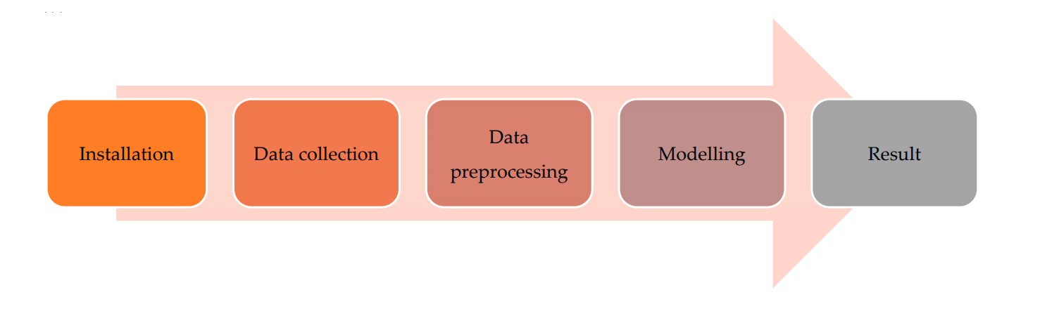
First level workflow

Slide 10
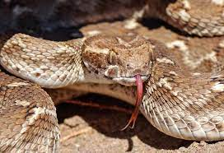
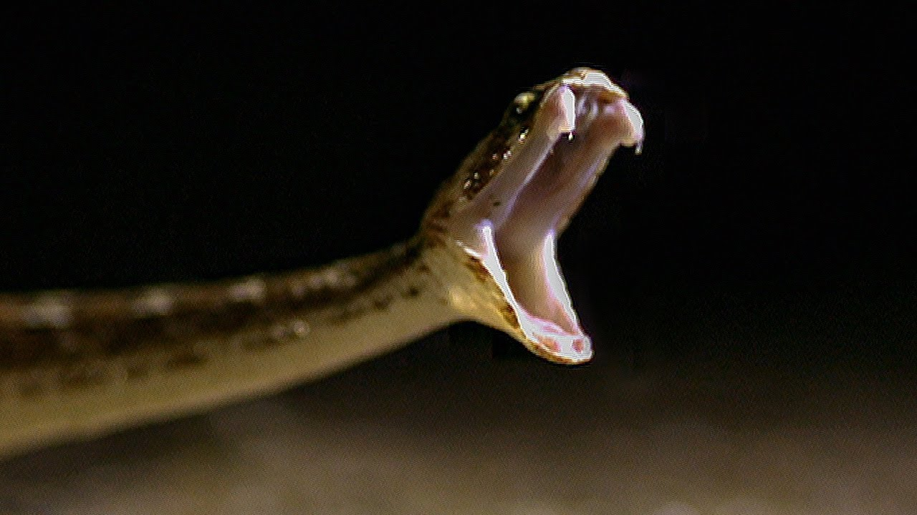
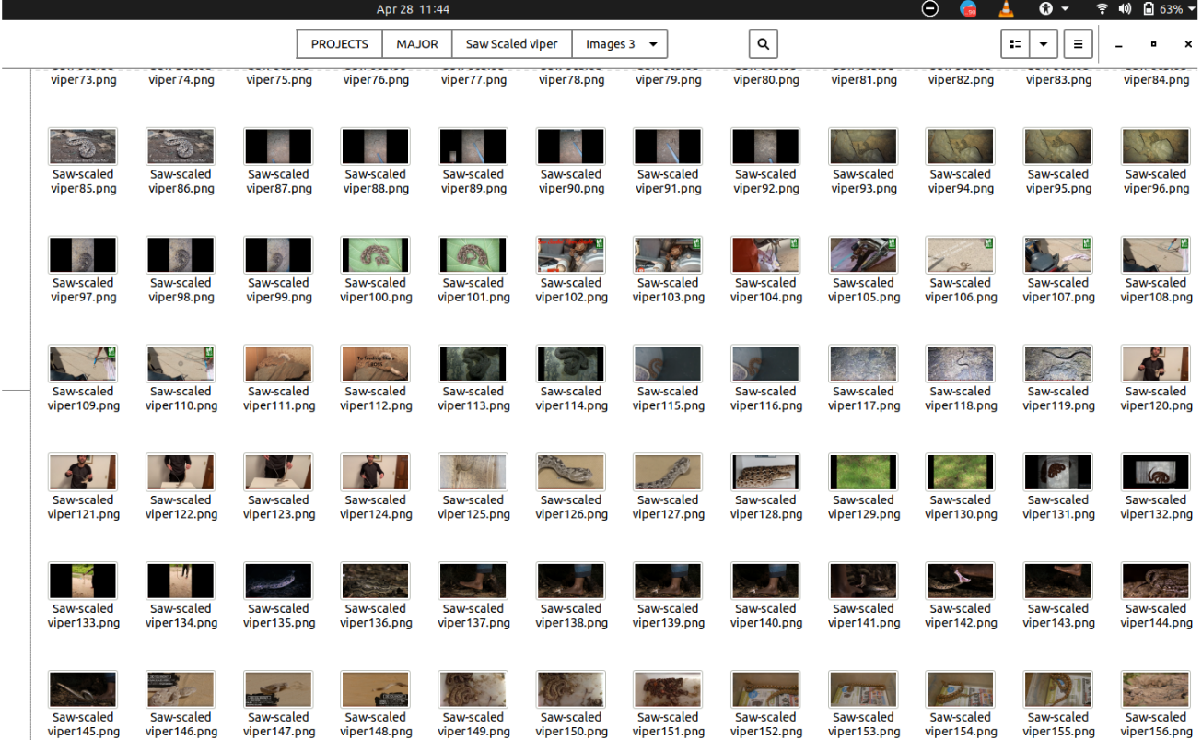
Dataset Resources
Created Our Own Custom Dataset with 510 Images of Saw-Scaled viper
160 Images from Web Sources ( Saw-Scaled viper Images from Desert , Tropical, Plains , Human Household etc).
Frames from youtube Videos Total 350 Images

Slide 11
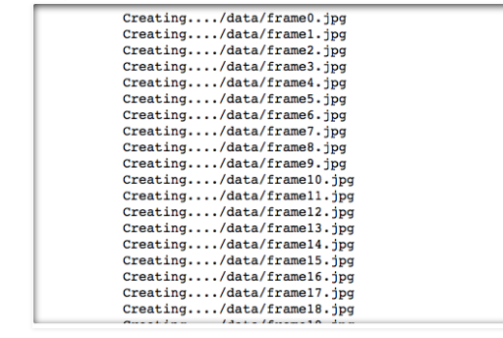
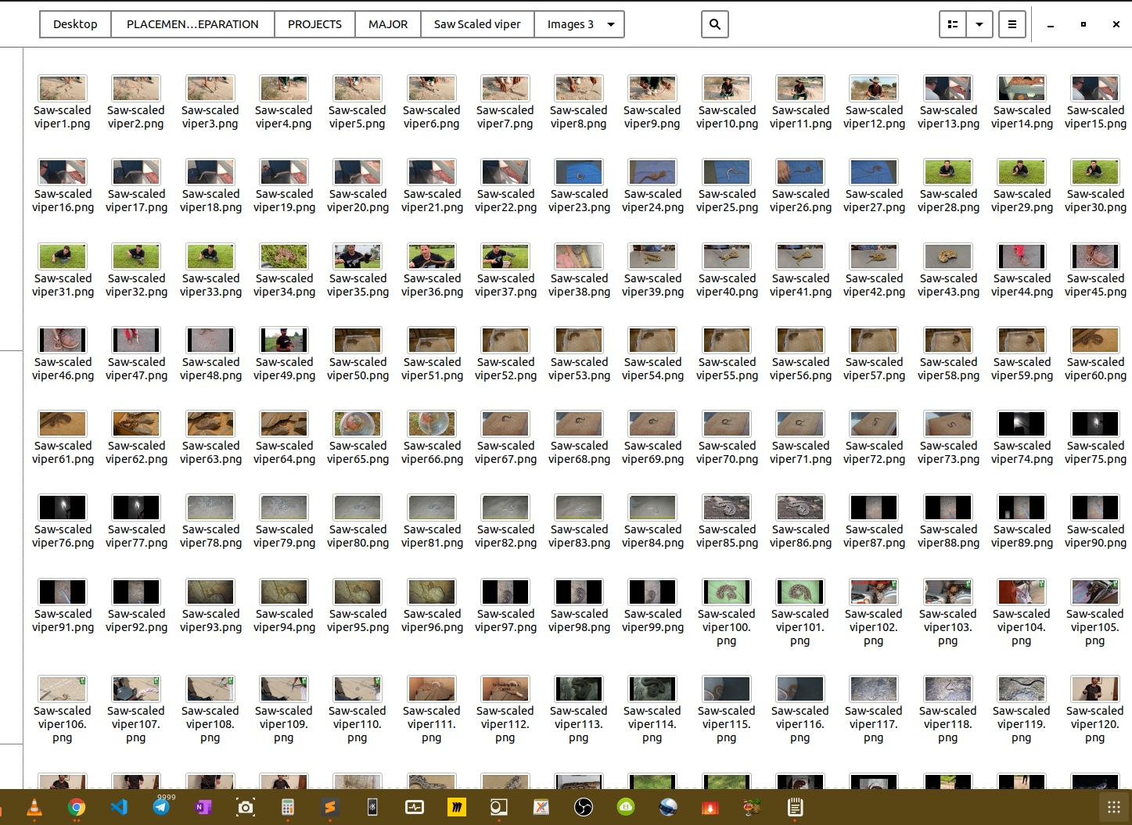
Handling videos and Frames Extraction
Multiple operations can be done on videos such as reading the file, scanning them, extracting frames and images from the videos and also saving the extracted frames and etc.. using openCV library the video can be taken as input and images can be extracted and further testing and training of the model can be done using this library. These are important functions used for capturing frames from the videos:
➢ VideoCapture(File_path) : This function is used to read the file in .mp4 format.
➢ read() : Considering the type of object called, this library is used to read the data.( Image file data)
➢ imwrite(filename,img) : The image is saved to the designated file.
All the extracted images will be saved in a Local folder

Slide 12
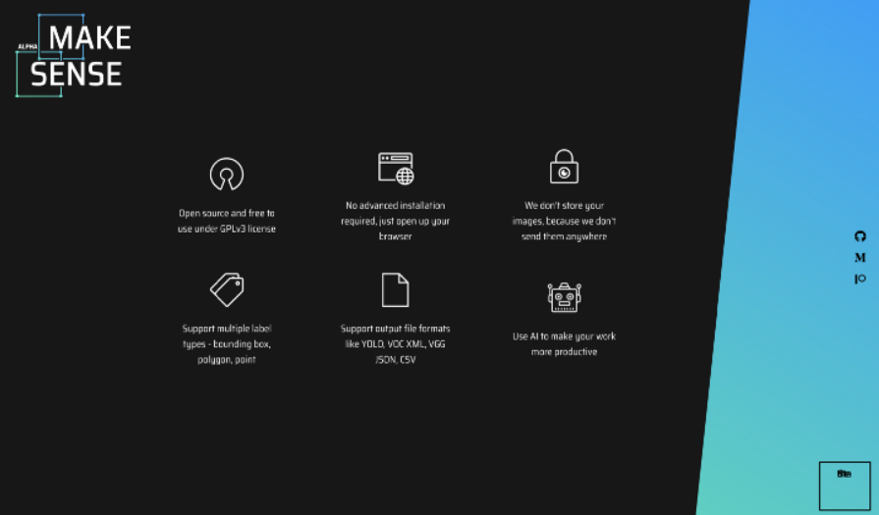
Step 2
DATASET PREPARATION
Taken Sample Images of Total 510 Saw-Scaled viper
Drawn boundaries around each Saw-scale viper.
Generated the labelled Annotation files in COCO dataset format.

Slide 13
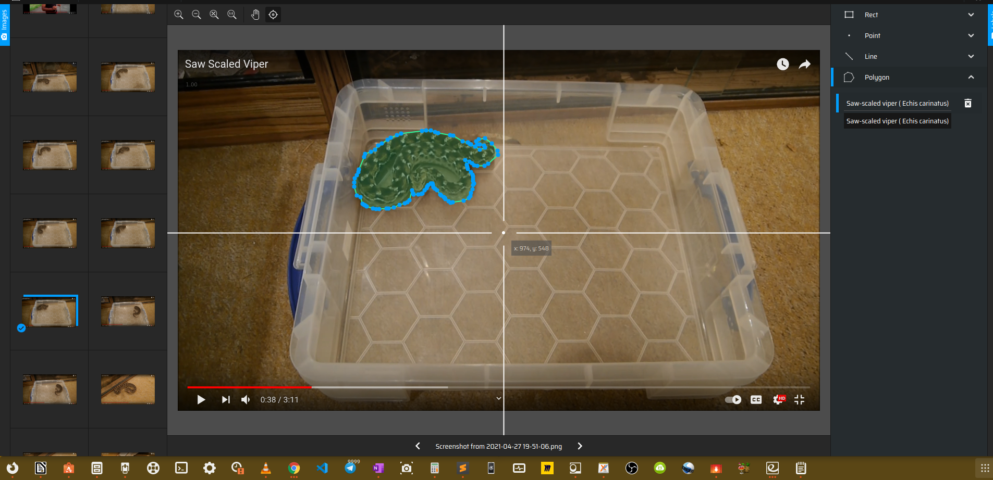
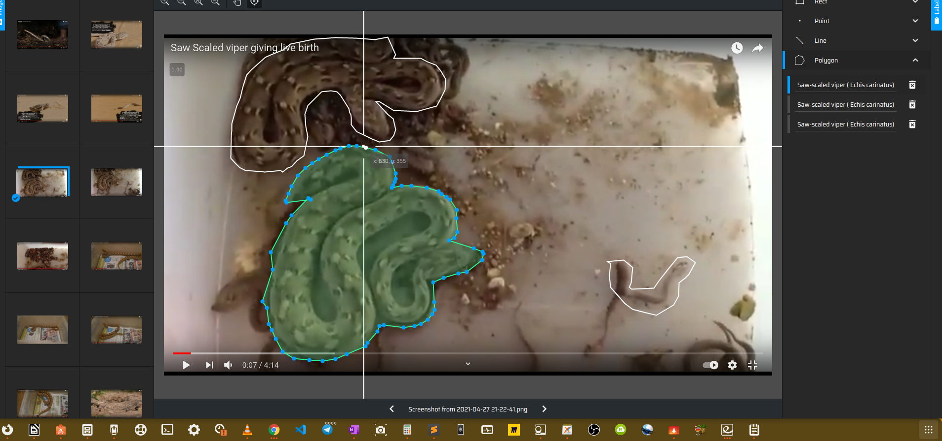
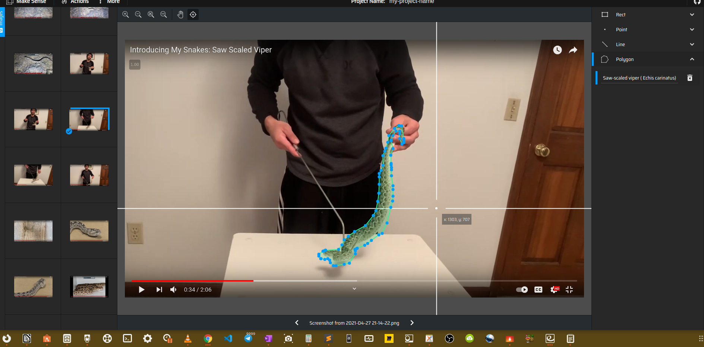
Step 3
Drawn Boundaries Around Each Images Saw-scaled viper.
Total of 510 Images Prepared.

Slide 14
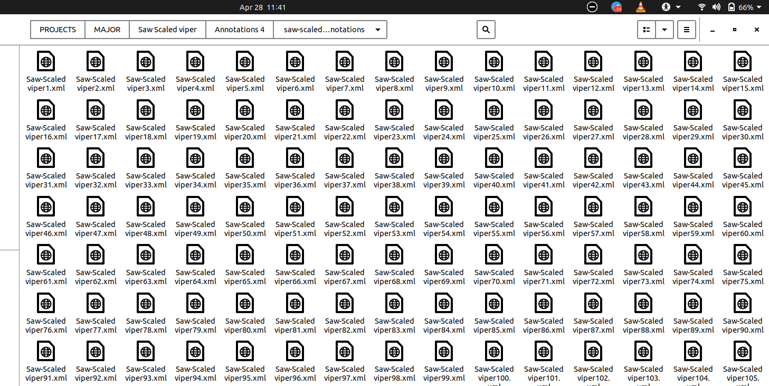
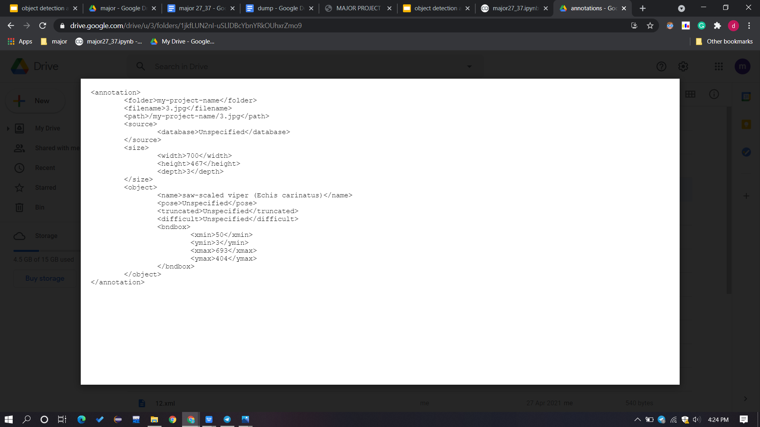
Step 4
Generated Annotation Files Corresponding to Each Image Mapped with original Image file

Slide 15
Image Preprocessing
Read image
Resize image
Remove noise(Denoise): using Gaussian blur (also known as Gaussian smoothing)
Segmentation :(segment the image, separating the background from foreground objects)
Morphology(smoothing edges)

Slide 16
Deep Learning Models Used
Mask-R-CNN

Slide 17
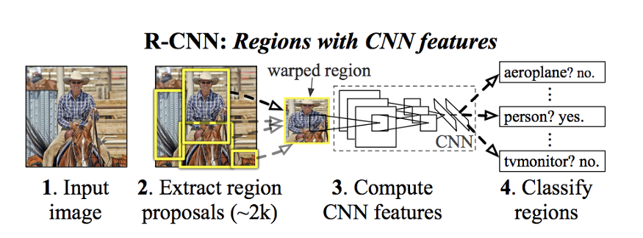
R-CNN
To bypass the problem of selecting a huge number of regions, Ross Girshick et al. proposed a method where we use selective search to extract just 2000 regions from the image and he called them region proposals.
Selective Search:
1. Generate initial sub-segmentation, we generate many candidate regions
2. Use greedy algorithm to recursively combine similar regions into larger ones
3. Use the generated regions to produce the final candidate region proposals
The CNN acts as a feature extractor and the output dense layer consists of the features extracted from the image and the extracted features are fed into an SVM to classify the presence of the object within that candidate region proposal.

Slide 18
Problems with R-CNN
It still takes a huge amount of time to train the network as you would have to classify 2000 region proposals per image.
It cannot be implemented real time as it takes around 47 seconds for each test image.
The selective search algorithm is a fixed algorithm. Therefore, no learning is happening at that stage. This could lead to the generation of bad candidate region proposals.

Slide 19
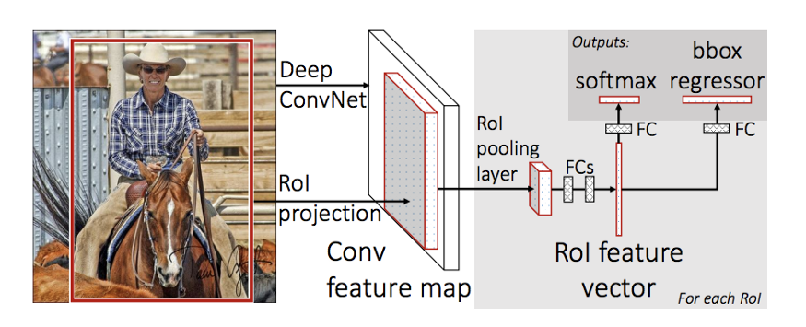
Fast R-CNN
The approach is similar to the R-CNN algorithm. But, instead of feeding the region proposals to the CNN, we feed the input image to the CNN to generate a convolutional feature map.
From the convolutional feature map, we identify the region of proposals and warp them into squares and by using a RoI pooling layer we reshape them into a fixed size so that it can be fed into a fully connected layer.
From the RoI feature vector, we use a softmax layer to predict the class of the proposed region and also the offset values for the bounding box.

Slide 20
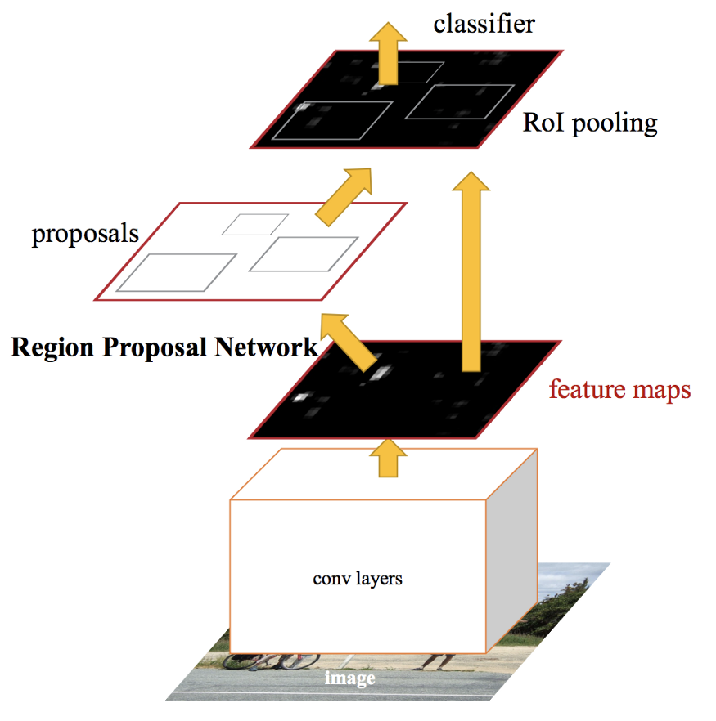
Faster R-CNN
Both R-CNN & Fast R-CNN uses selective search to find out the region proposals which is a slow and time-consuming process affecting the performance of the network.
Faster R-CNN lets the network learn the region proposals.
Similar to Fast R-CNN, the image is provided as an input to a convolutional network which provides a convolutional feature map.
Instead of using selective search algorithm on the feature map to identify the region proposals, a separate network is used to predict the region proposals.
The predicted region proposals are then reshaped using a RoI pooling layer which is then used to classify the image within the proposed region and predict the offset values for the bounding boxes

Slide 21
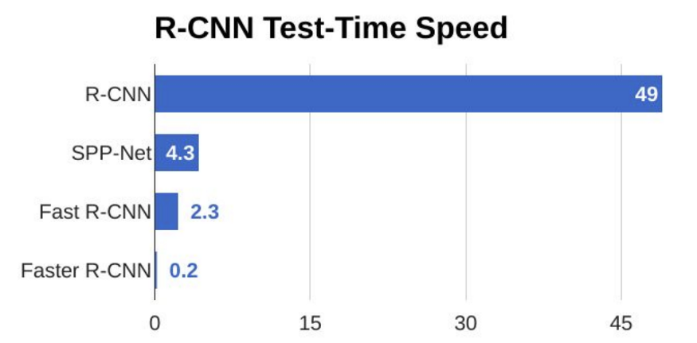
Comparision

Slide 22
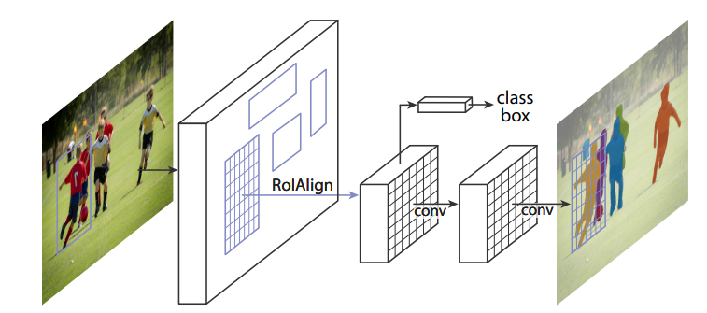
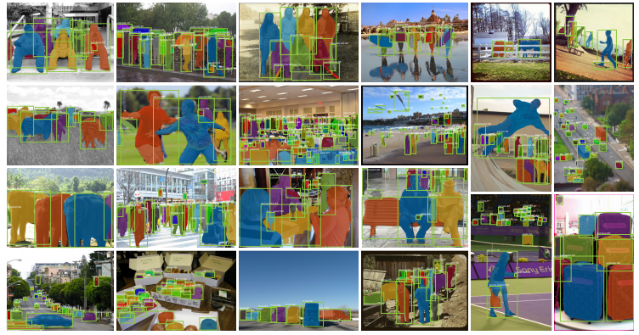
Mask R-CNN
(Extending Faster R-CNN for Pixel Level Segmentation)

Slide 23
Mask R-CNN adds a branch of Fully Convolutional Network on top of a CNN based feature map to Faster R-CNN that outputs a binary mask that says whether or not a given pixel is part of an object.
Inputs: CNN Feature Map.
Outputs: Matrix with 1s on all locations where the pixel belongs to the object and 0s elsewhere (this is known as a binary mask).
Pre trained Coco(Common Objects In Context) dataset which consists of 90+ objects with about (123,287 images, 886,284 instances)

Slide 24
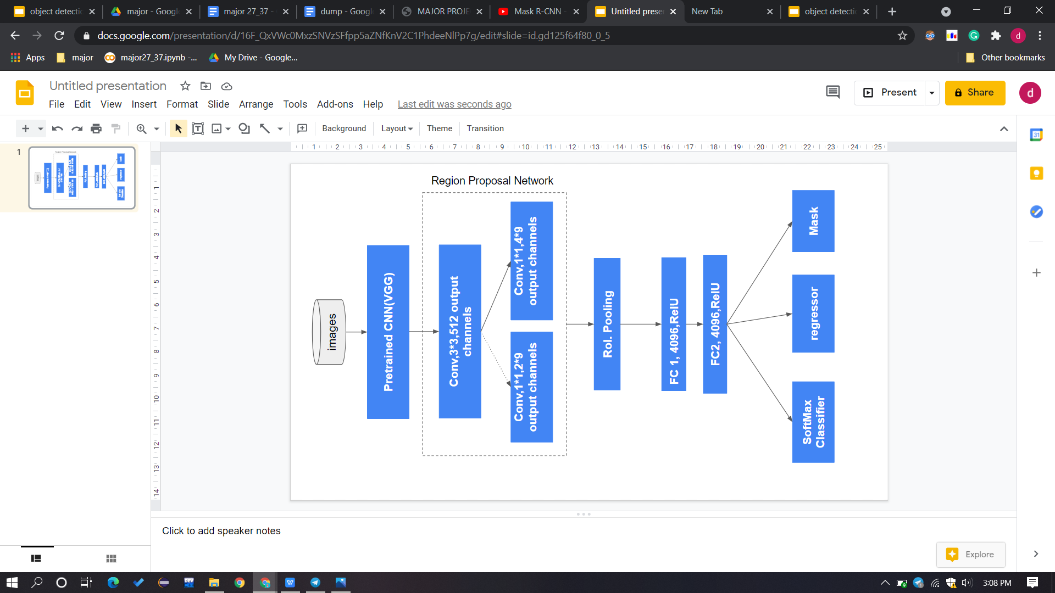
Second Level architecture

Slide 25
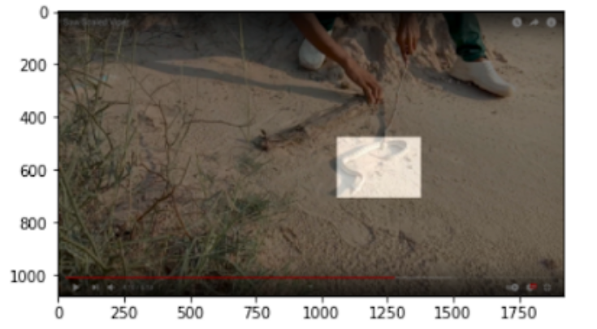
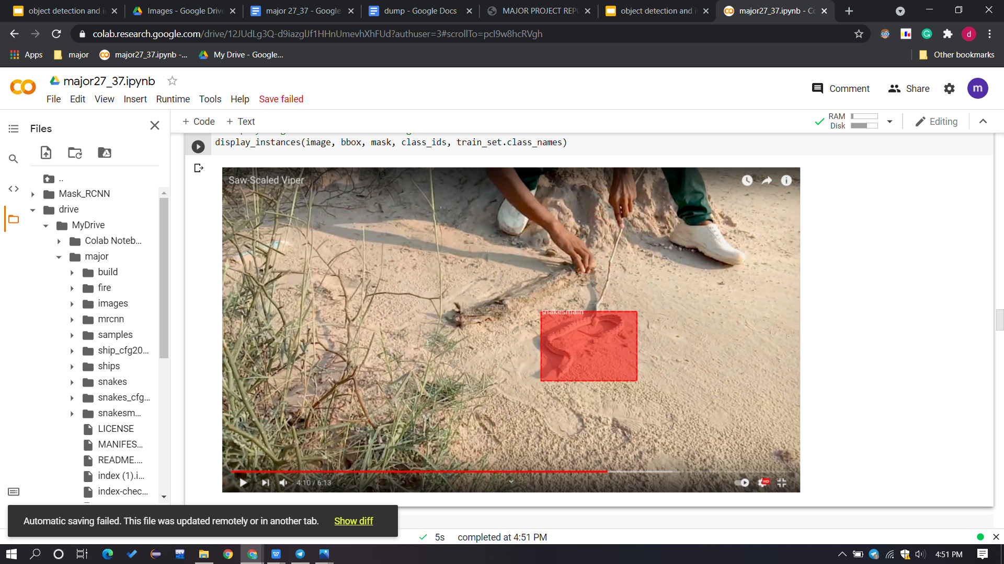
Model Training
Train : 408( 80%)
Test : 102( 20%)

Slide 26
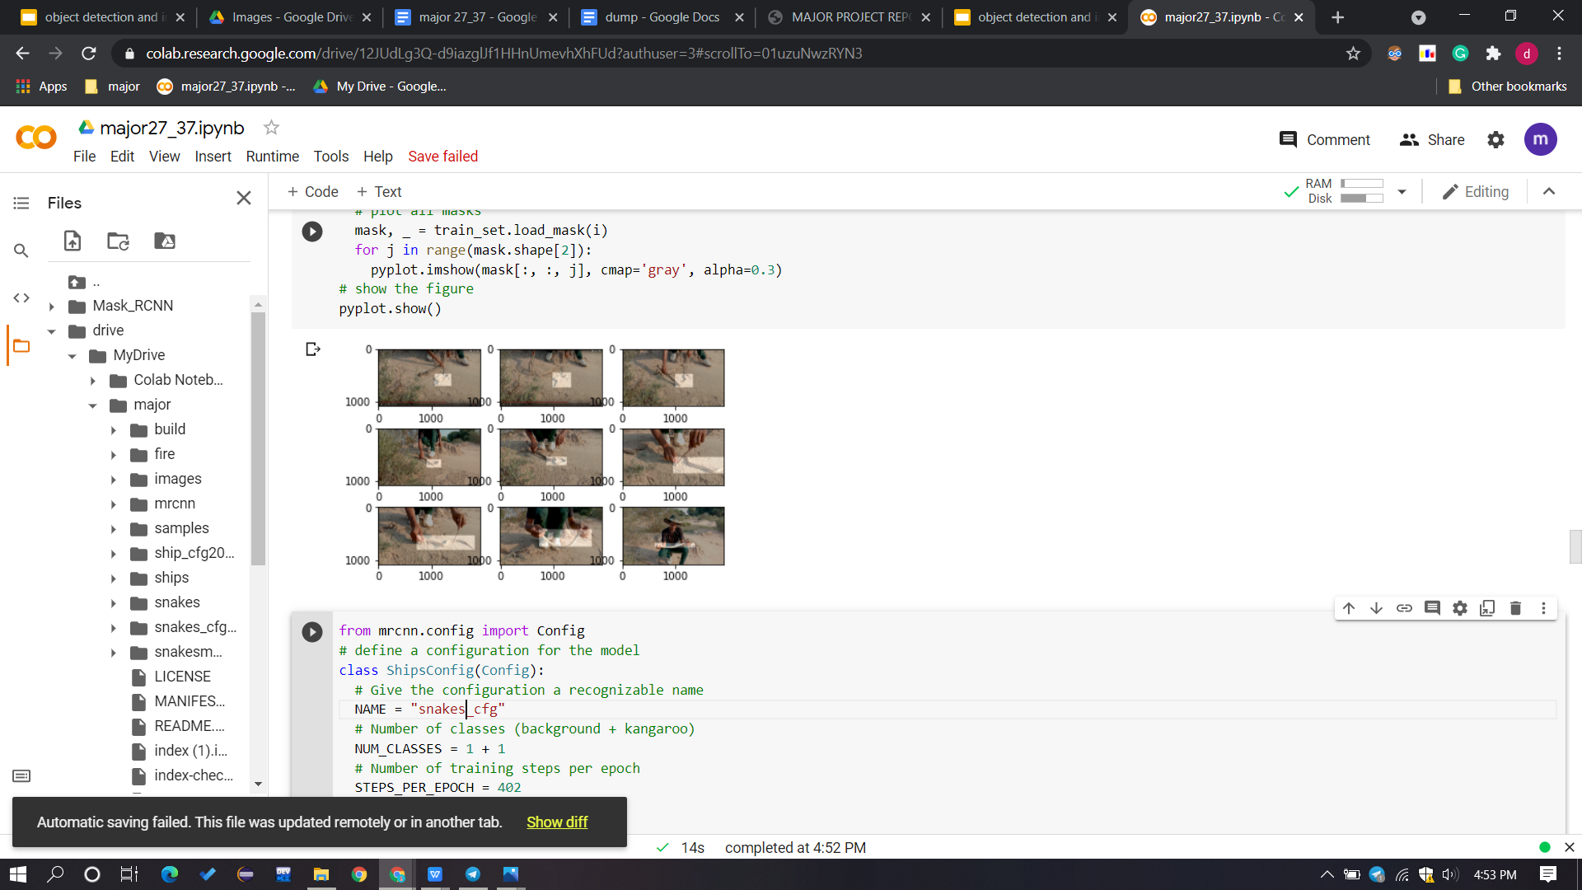
Subplot of first nine Images with mask over snake area

Slide 27
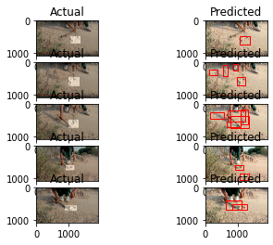
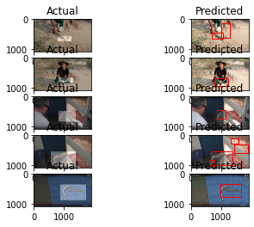
Actual vs. Predicted Images

Slide 28
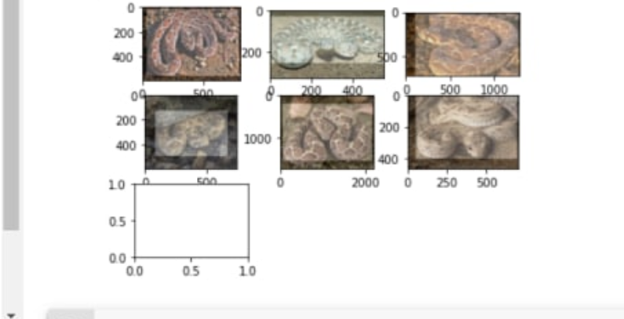
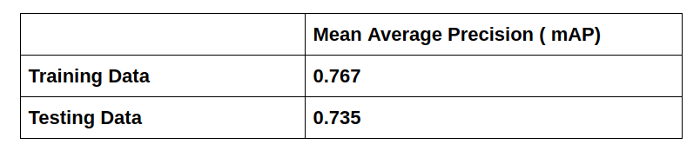
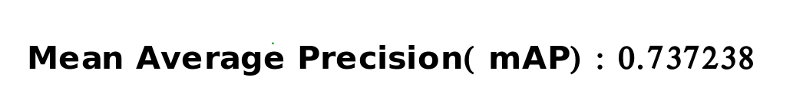
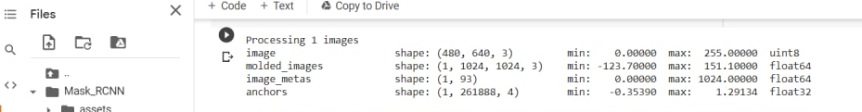
Result
Mean Average Precision

Slide 29
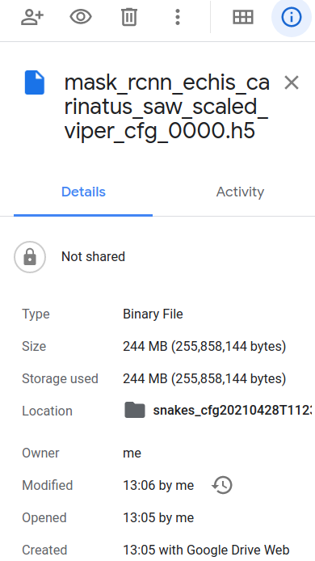

CONCLUSION
&
Our Contribution
Pre Trained Mask-R-CNN Model on COCO Dataset
+
Mask-R-CNN Model Trained in Our own Custom dataset
( echis carinatus ).

Slide 30
Scope and Usability
Detection System + Alarm System
Locations - Home, parks, Schools, Human Civilisation regions etc.
Reduce number of bites and Deaths.
Can be Implemented in Drones and Robots for Detection of Echis Carinatus and Venom Extraction purpose.

Slide 31
Thank You :>

